Slide 1
Module 1.1:
ML Basics
Representation; Model Fitting;
Prediction; Generalization
ML for Cybersecurity
Notes:
Motivation why we are interested in theory
Not just applying another machine learning algorithm to the data
Understanding failure cases
Understanding buzz words

Slide 2

Taxonomy of “Classical” ML Models
Notes:
Matt/Laura:
This might be part of the presentation—but it would be worth explaining what “Classical” ML models and “Statistical Machine Learning Framework” mean—i.e., is this to distinguish them from a non-classical or non-statistical approach?

Slide 3
Elements of Statistical Learning
Notes:
Matt/Laura:
Might be part of your plan—but it could help to explain these with a concrete example illustrating what’s going on here (so you could say e.g. what in the given scenario the domain set would be, the objective would be, etc.)
Would also just be really explicit about how, as practitioners, they would be interacting with, say, loss functions, and where different loss functions might be good choices etc.

Slide 4
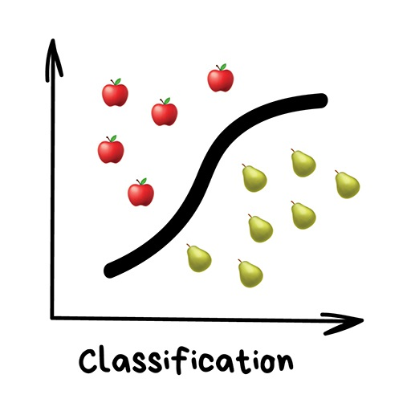
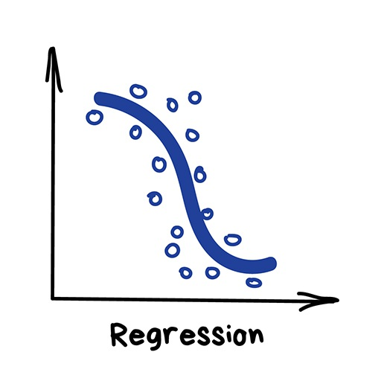
The Statistical Machine Learning Framework
Data
Domain set
Label set
A joint probability distribution on training data
Model
A prediction function
Measure of success
A loss function

Slide 5
Measurement of Success
Given the prediction function and the loss function, the loss of an example is
Training error/ empirical error of
Generalization error/ risk/ true error

Slide 6
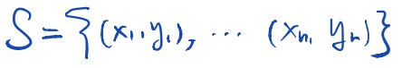
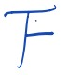
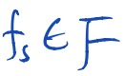
Learning Objective
Given
a collection of observations,
a model class,
The goal of learning is to determine an estimator
that best matches the observation (i.e., with the minimal error w.r.t. a certain loss function)

Slide 7
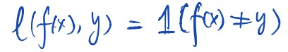
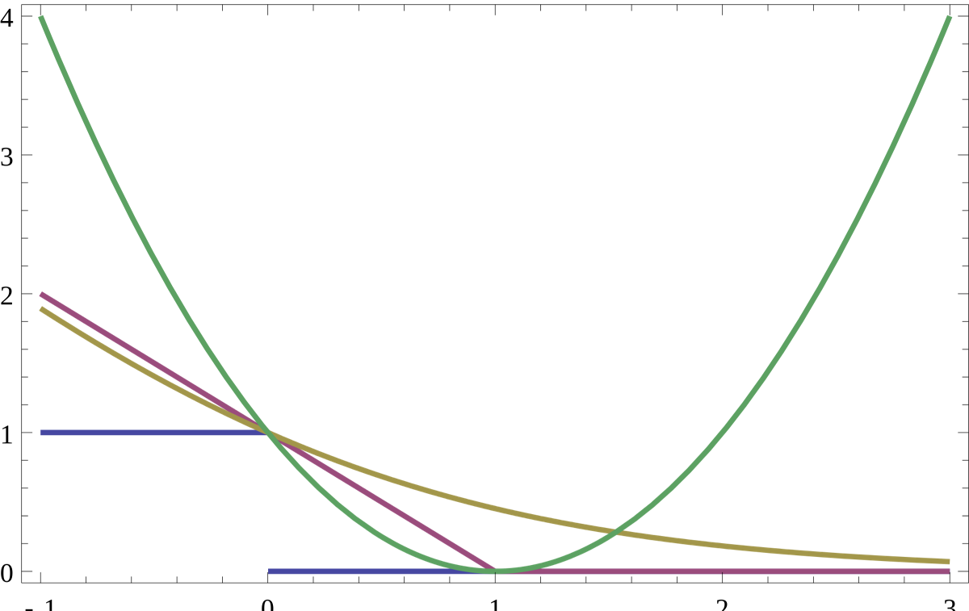
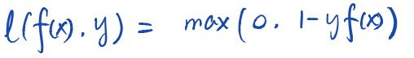
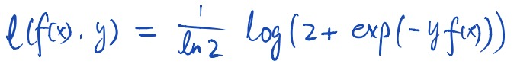
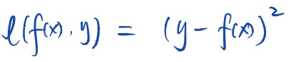
Example of Loss Functions (Classification)
0-1 loss:
misclassification error
hinge loss :
penalize correct predictions when not confident
log loss:
always wants more “margin”
square loss
magnify penalties if is large
Notes:
Connection to running examples in the context of classification tasks (e.g., spam filtering)

Slide 8
Regularization
Notes:
Matt/Laura:
Just want to make sure there’s some sort of transition here, moving from basic ML terminology and objectives to regularization
Likewise, any concrete example(s) you can bring to bear here to illustrate would be extremely valuable

Slide 9
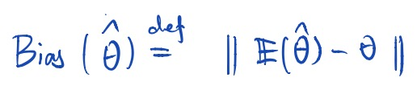
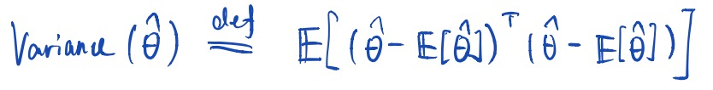
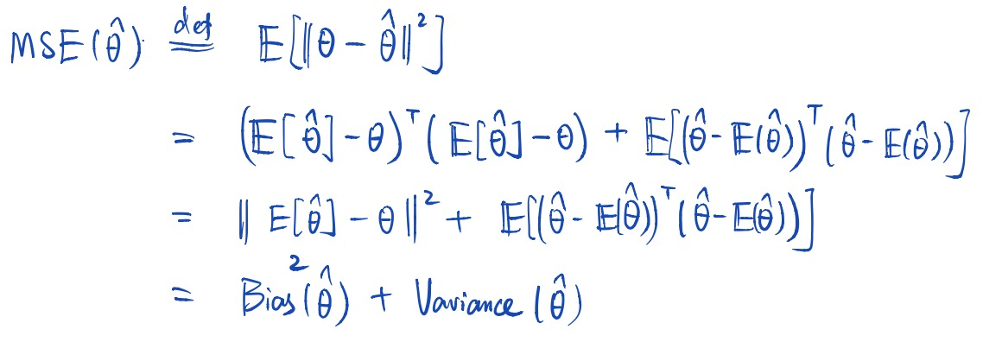
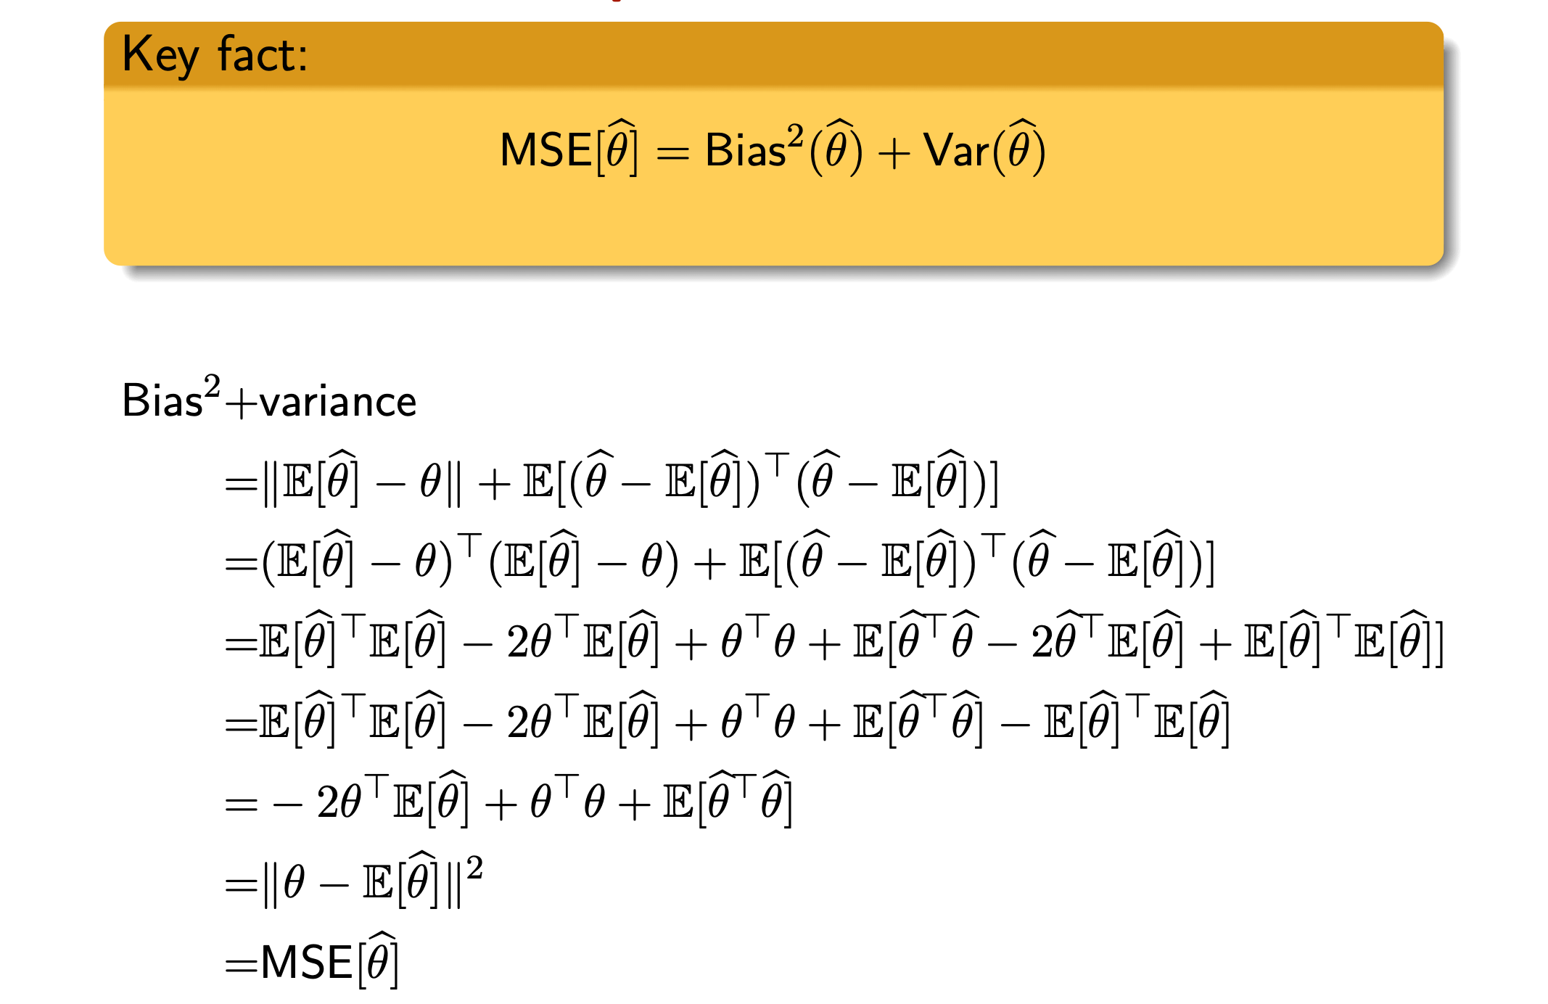
Bias-Variance Decomposition
Bias
Variance
MSE

Slide 10
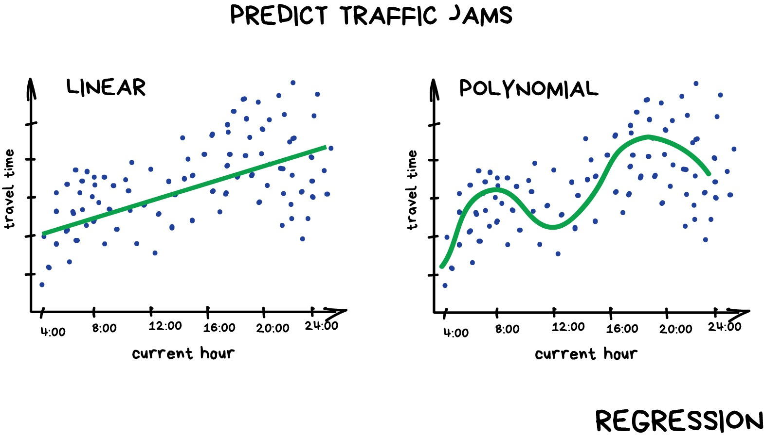
Bias Variance Tradeoff
bias
variance
MSE
k

Slide 11
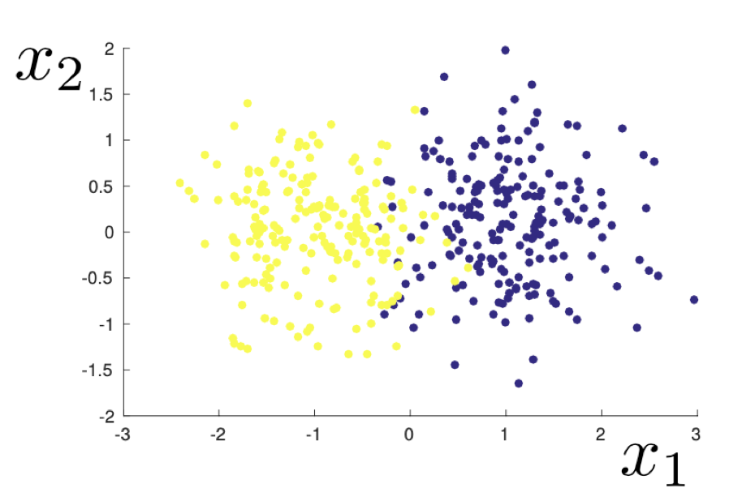
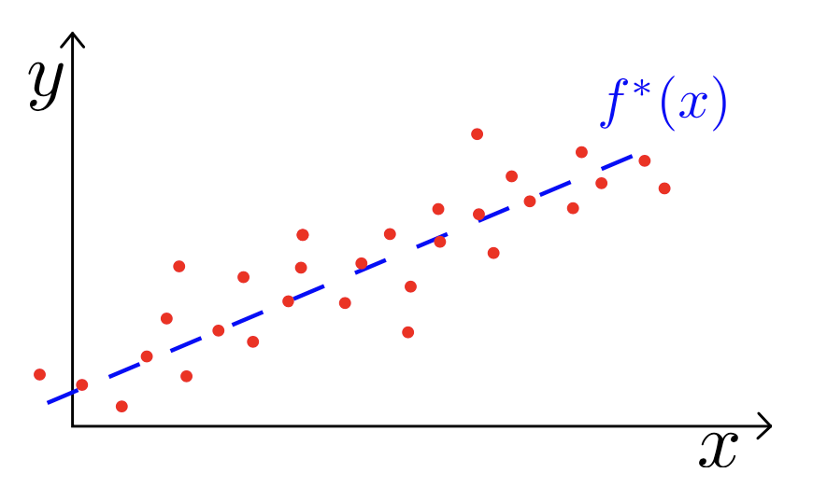
Stability, Overfitting, and Regularization
2D example of a dataset sampled from a mixed Gaussian distribution
Fixed unknown linear function

